Slide 1

Library Recommendation Method ECE-GY 6143 Machine learning
Danyi Fu N19965830 Jitian Chen N15808851

Slide 2
What is the problem you are trying to solve?
My(Danyi Fu) mother is the dean of Quanzhou Normal University library, so we get the some reader data. So we use the 4 years reader borrow record of Quanzhou Normal University library to predict what kind of books will individual college students want to borrow and then we can recommend books to them. We divide students into different class regarded with their class years(freshman, sophomore,junior,senior), sex identity and majors. And we use Chinese books classification principal to divide all the books into 22 groups.

Slide 3
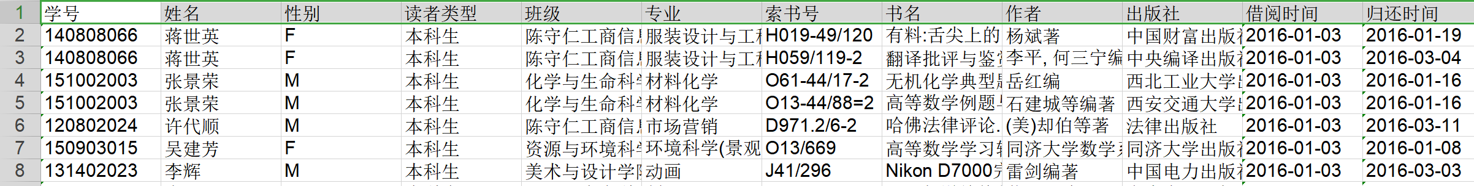
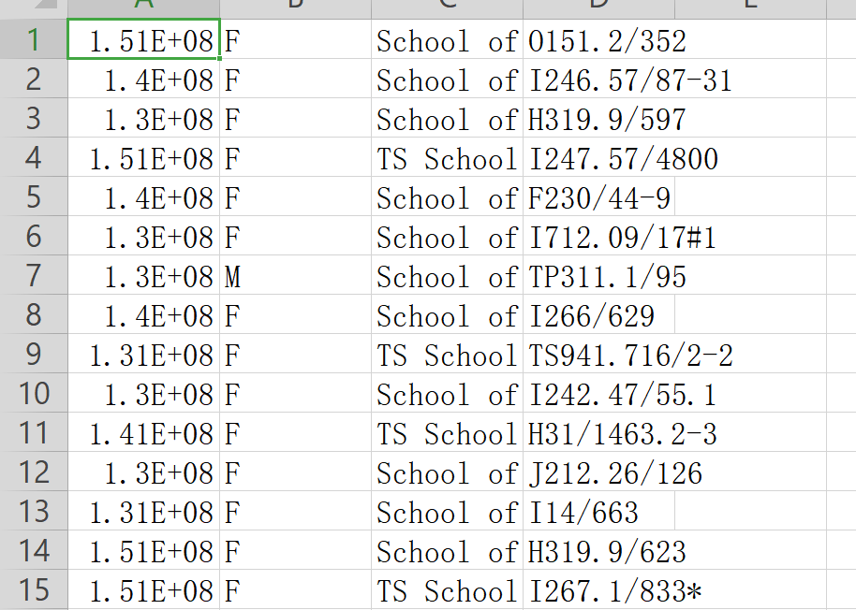
Original data
Modified data
We only use 4 columns of data in which student ID, gender, school are used as features and the type of
books(first character of string number of book) as result. We will recommend books to individual students according to result.

Slide 4
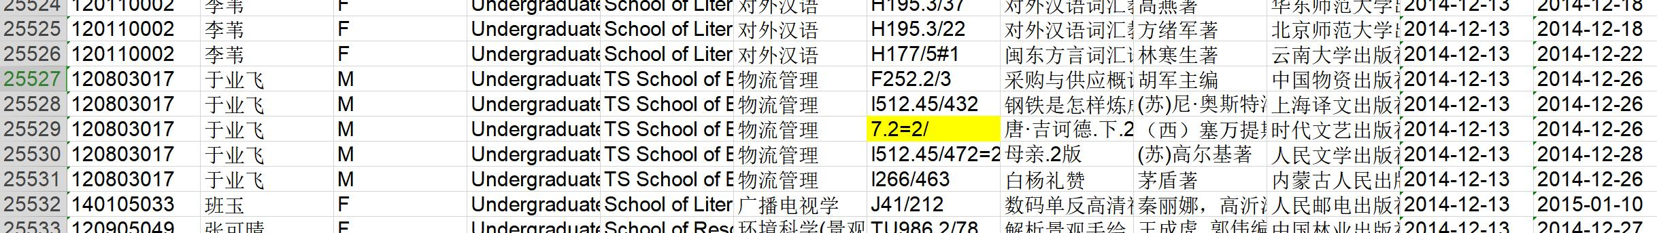
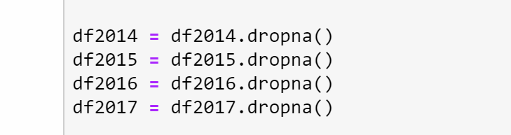
Data pre-process by Excel
Because library borrow record machine has little problem sometimes, so the orginal data has some wrong samples.
Some problems like above.
We also use dropna() to delete some samples lack contents

Slide 5
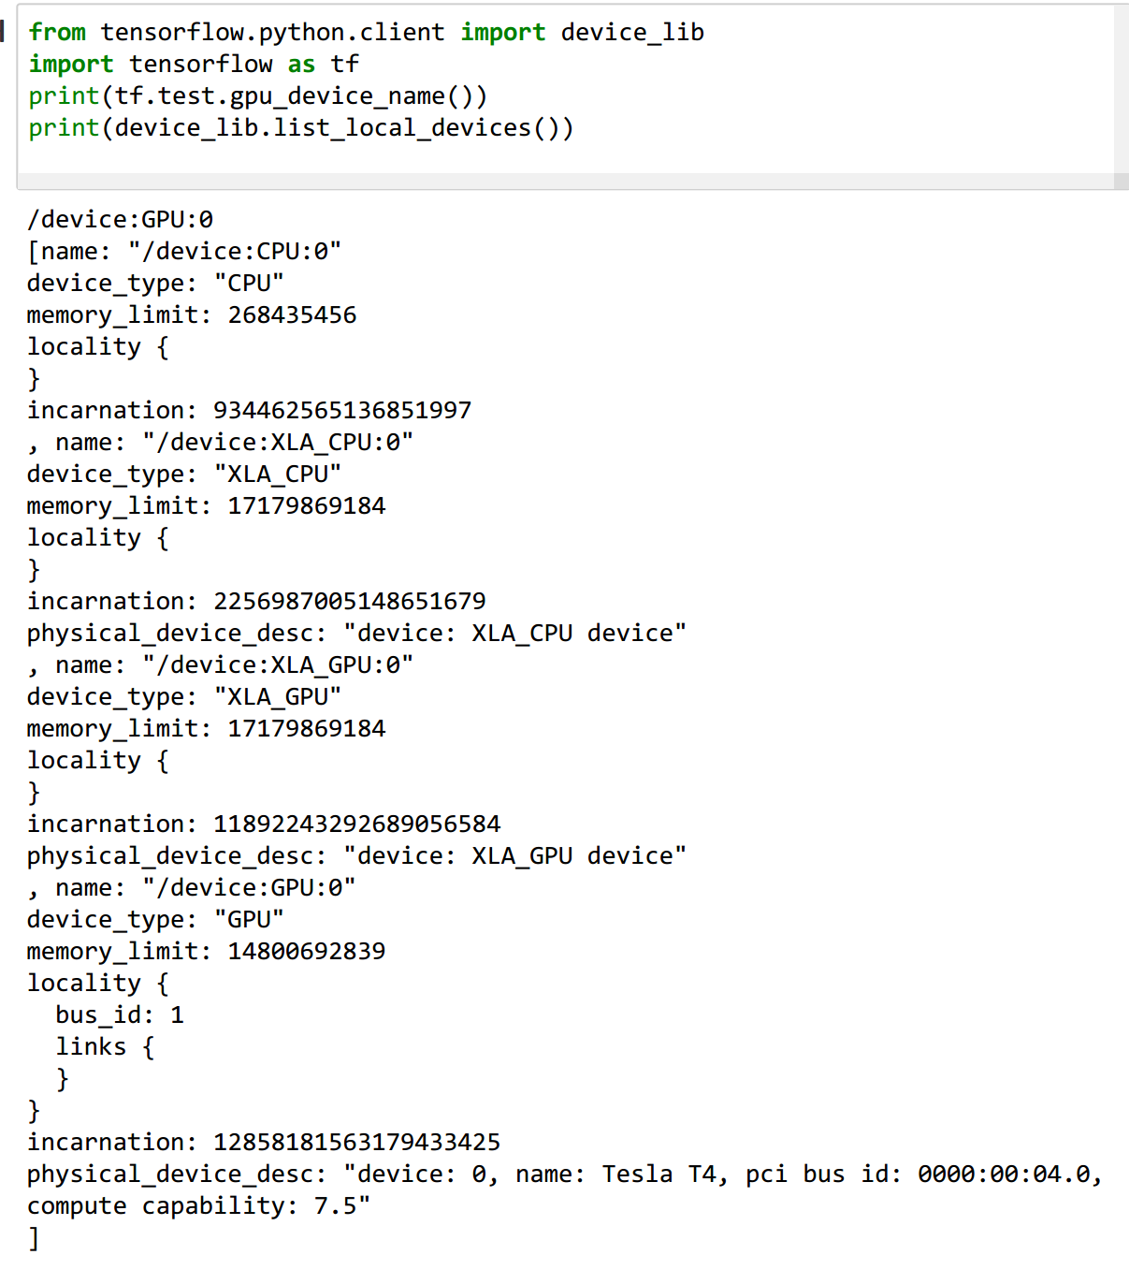
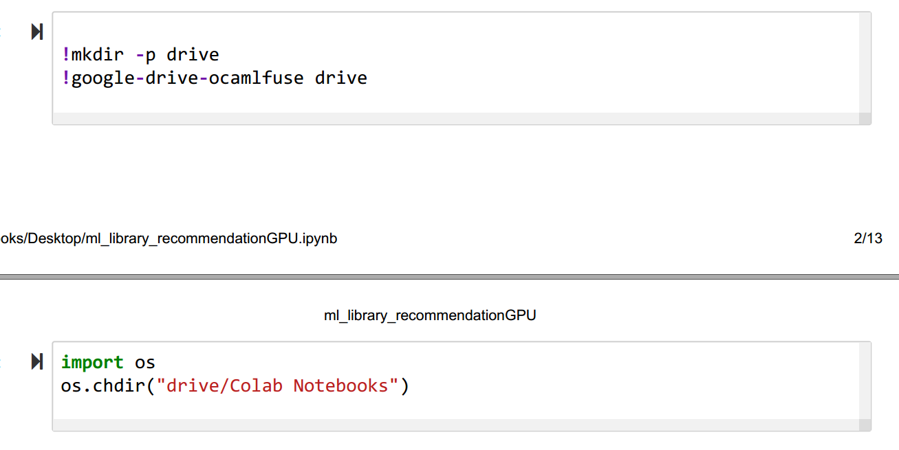
We run it in Google Colab and use GPU. And we store data in Google Driver

Slide 6
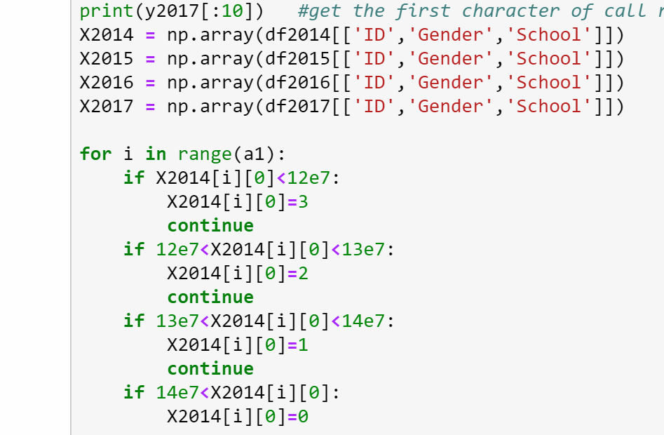
We translate the students ID to their class of years.
0 represents freshman, 1 represents sophomore, 2 represents junior, 3 represents senior

Slide 7
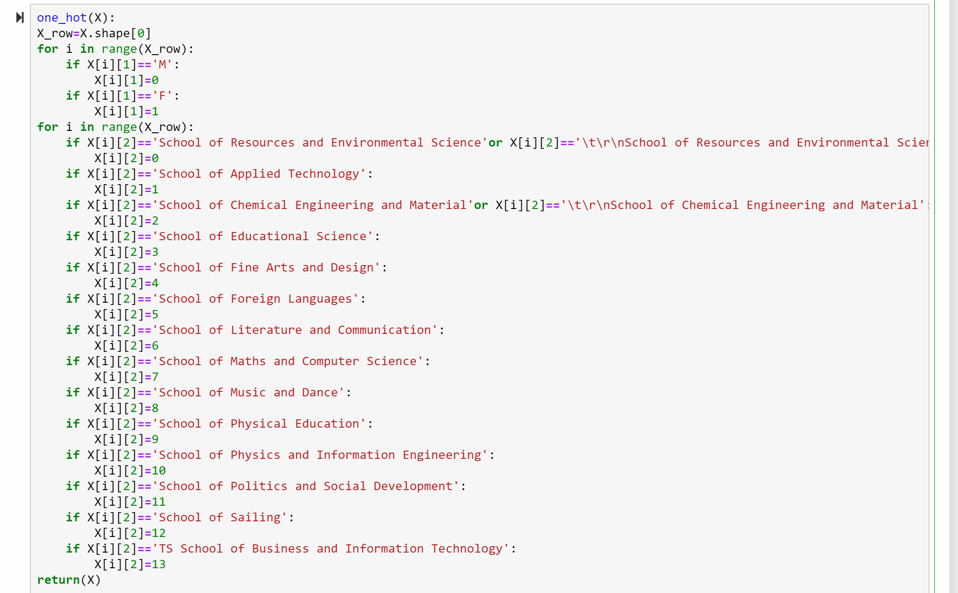
One-hot coding

Slide 8
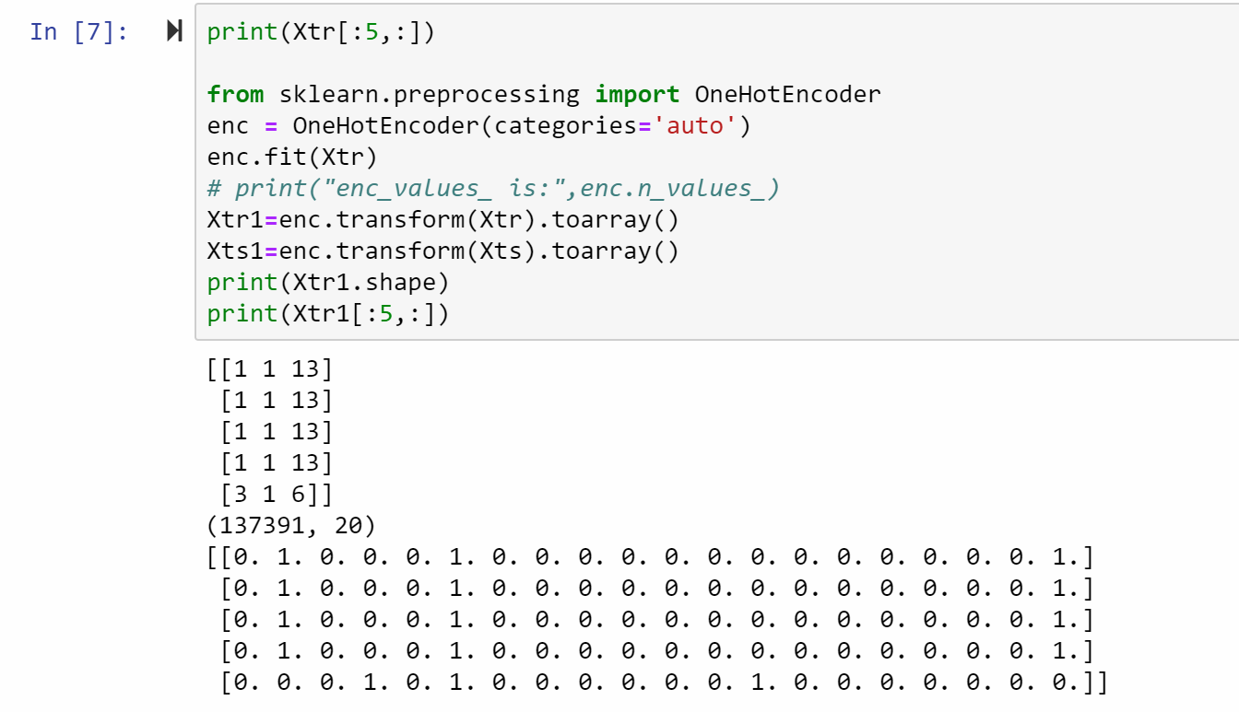
The dataset modified by one-hot coding

Slide 9
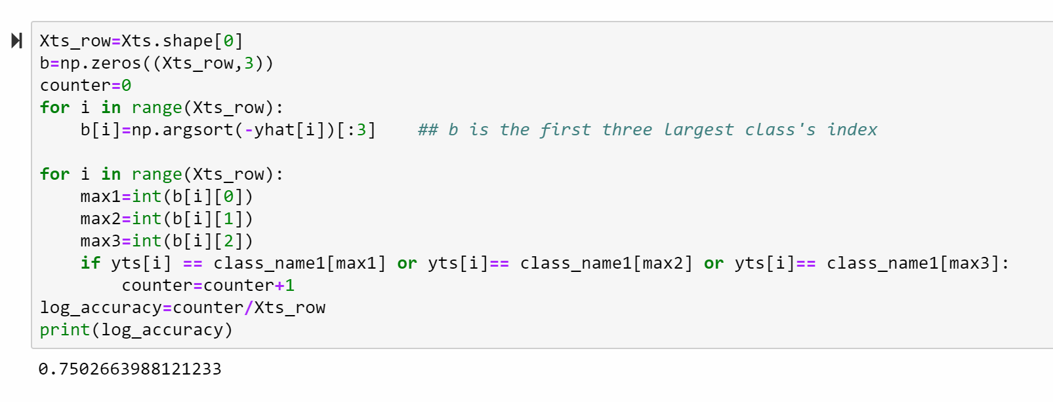
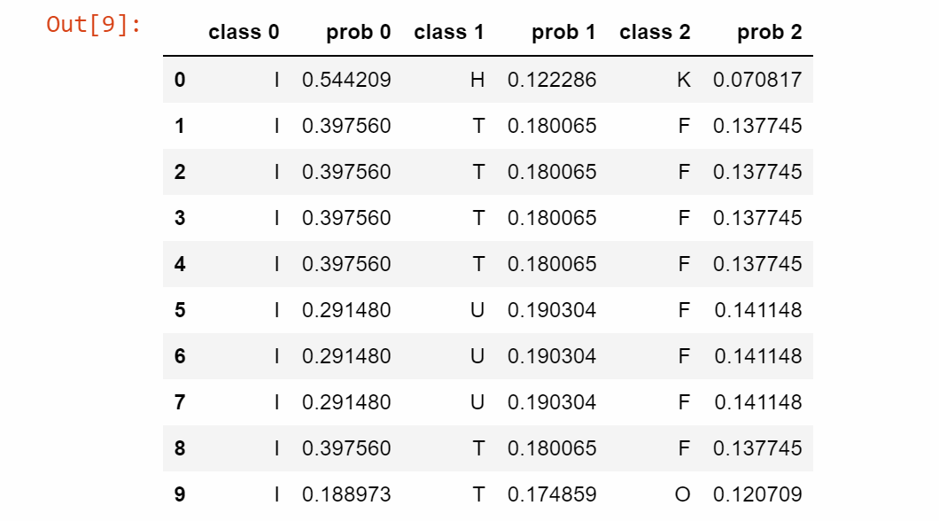
1.LogisticsRegression:
Result of 10 samples
If yts match one of the first three largest probability result(yhat), we consider it is correct. And we will recommend students with these three kind of book.

Slide 10
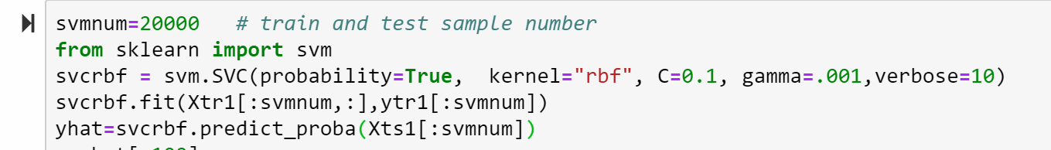
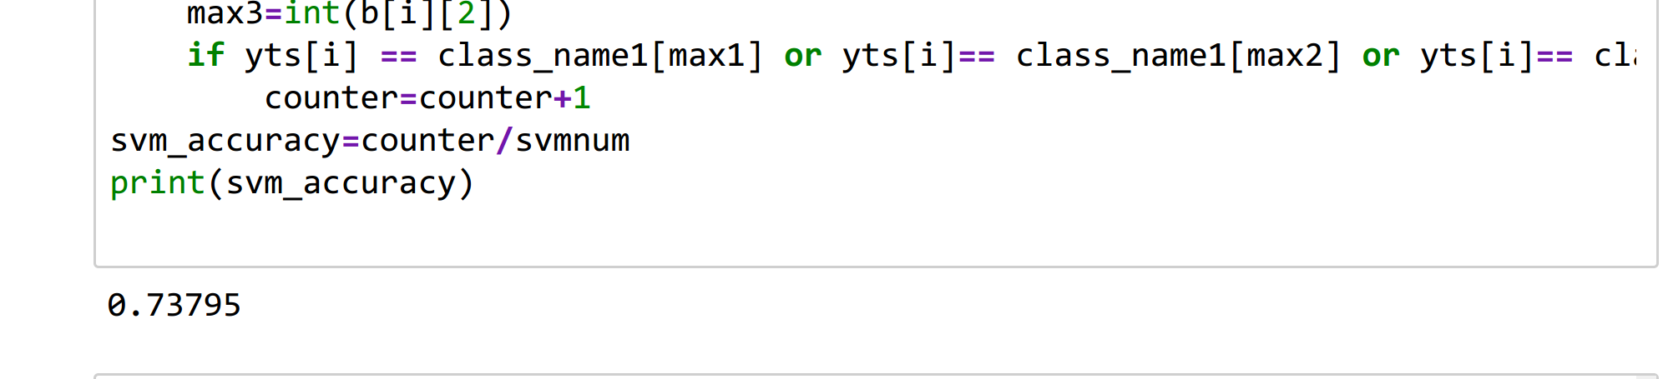
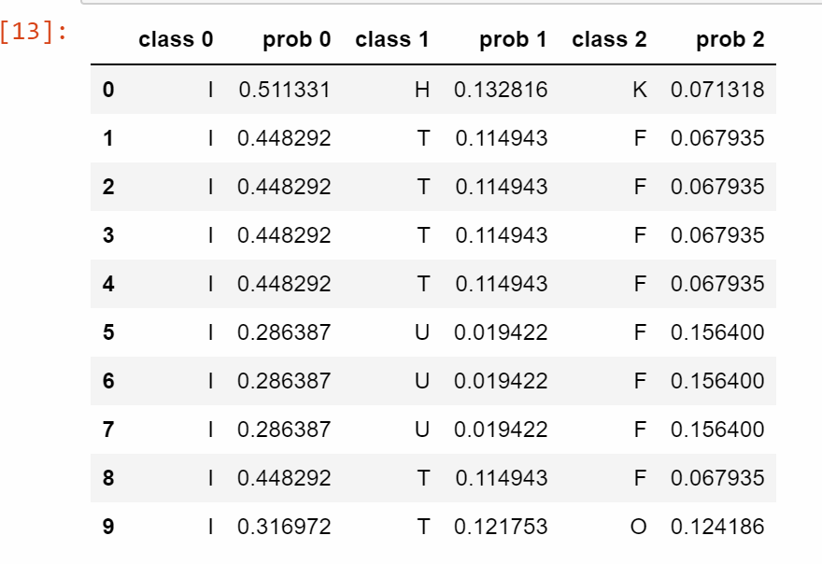
2.SVM:
Because we have more 130,000 trainning samples, it take too much time to train the model even using GPU. So we choose to train only 20,000 samples
Result of 10 samples
Accuracy rate. The measure method is the same as LogisticsRegression.

Slide 11
Summary
The accuracy of these two methos are not so good. This is problem is a typically One-Hot Coding implement scenrio. Because the data have 4X2X14=112 kinds of features, and have 22 kinds of result, so the data is sparse and had to fit by Regression and SVM.
The features like students' class of years aren't strongly related to what kind of books they want to borrow. In addition, eveyone is unique and have different hobbies, it is not exact to just divide undergraute by such features.

Slide 12
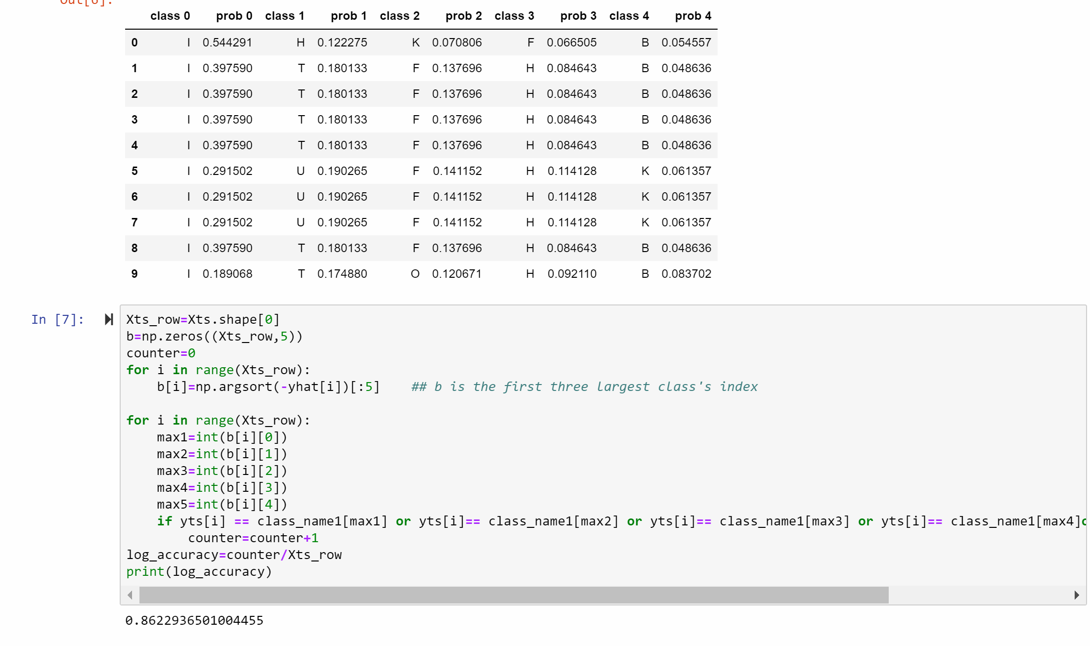
If we choose the the first five largest probability result(yhat), it means recommend students five kinds of books, the accuracy will increase.
In the future, we will try some deep learing methods like RNN model to solve this problem to get a more higher accuracy.

